Slide 1
clipboards
glue sticks
markers
crayons
colored pencils
scissors
rulers

Slide 2
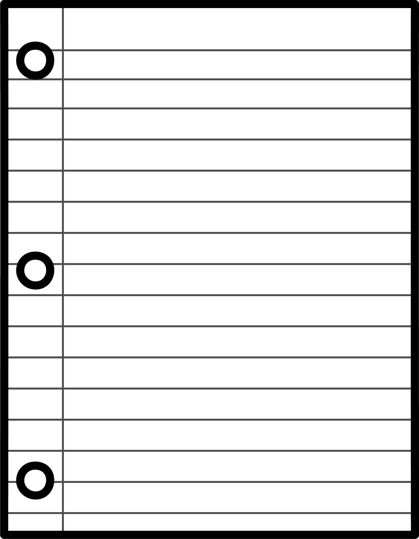
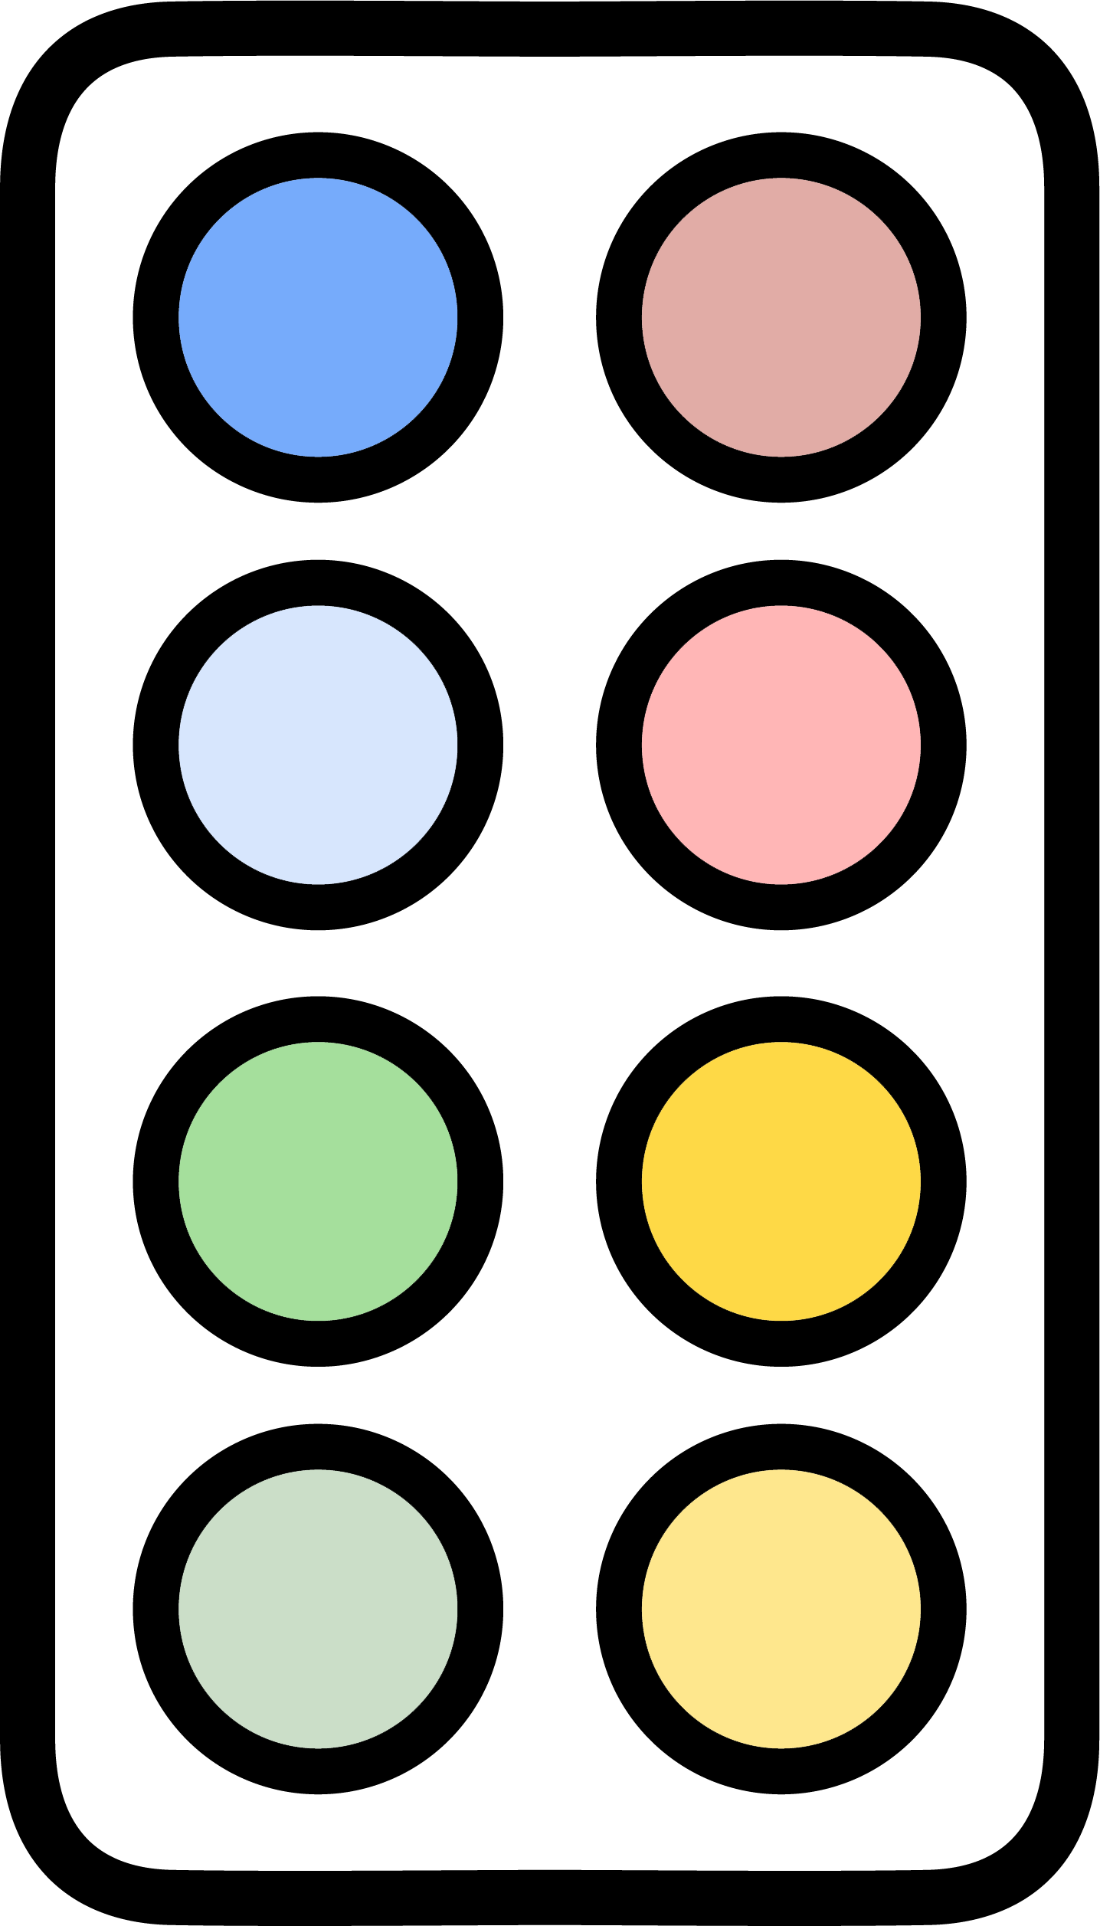
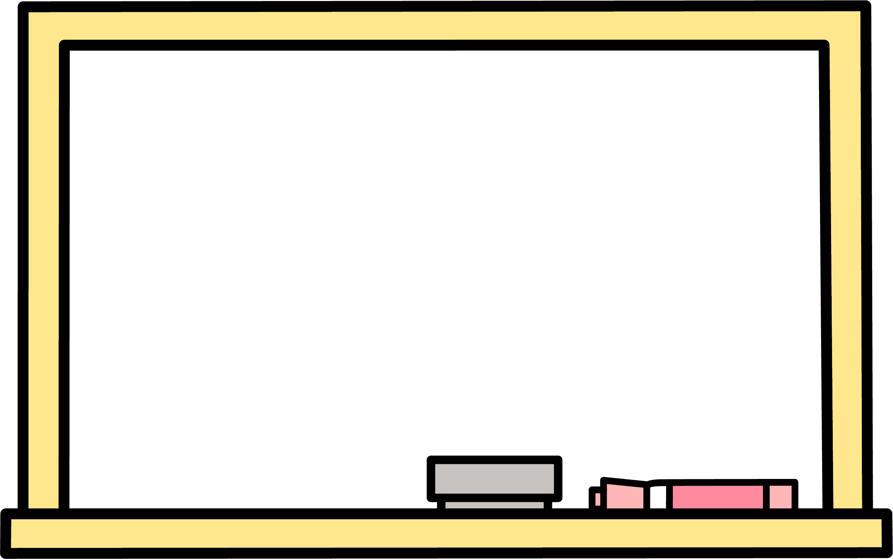
paper
teachers
notebooks
paint supplies
pencils
teachers
whiteboards

Slide 3
teachers
teachers
teachers
crafts
crafts
teachers
games

